Slide 1
FIFA WORLD CUP ANALYASIS (1930-2014)

Slide 2
INTRODUCTION
A FIFA World Cup analysis from 1930 to 2014 is like looking back at the history of soccer. It's about studying all the World Cup tournaments that happened during those years. It's a super famous soccer competition where countries play against each other to be the best in the world. They play matches, score goals, and try to win. The World Cup started way back in 1930 and has been happening every four years since then (except for a break during World War II). This analysis is going to look at all the World Cups from 1930 to 2014. We'll see which countries won the most, who scored the most goals, and other interesting things about the biggest soccer tournament.

Slide 3
HOW I STARTED THIS PROJECT
1. Get Your Data: Firstly, I collected my Amazon sales data. This can include information like sales revenue, product details, customer feedback, etc.
2. Open Power BI Desktop: I downloaded Power BI Desktop on my laptop.
3. Connect to Data: I clicked on "Get Data" and selected my data source ( Excel file). Chose my Amazon sales data file and loaded it into Power BI.
4. Transform Data: Then I used Power BI's data transformation tools to clean and organize my data. This might involve renaming columns, removing duplicates, or formatting data types.
5. Create Visualizations: I designed my dashboard by adding visualizations such as charts, graphs, and tables.

Slide 4
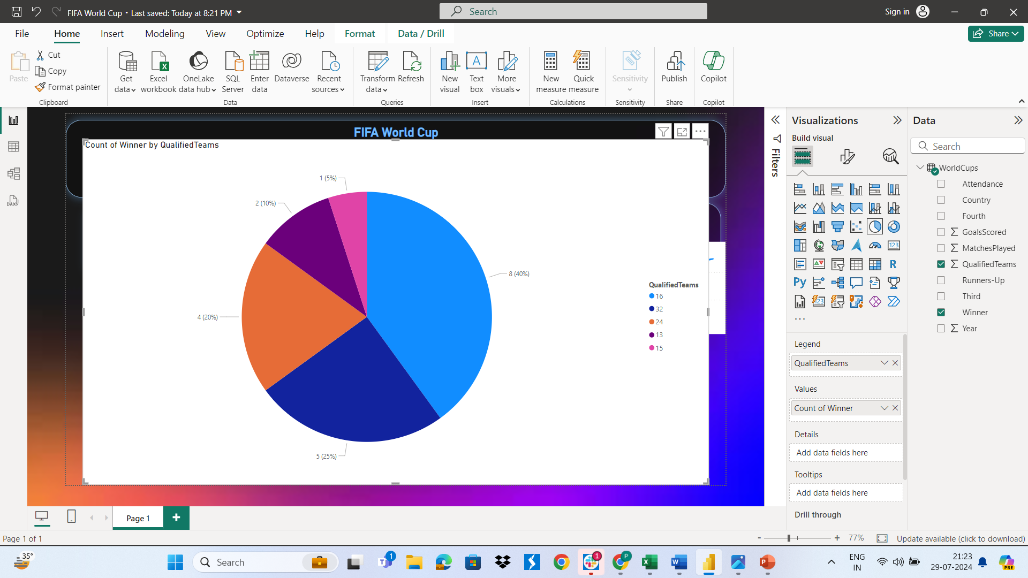
COUNT OF WINNER BY QUALIFIED TEAMS

Slide 5
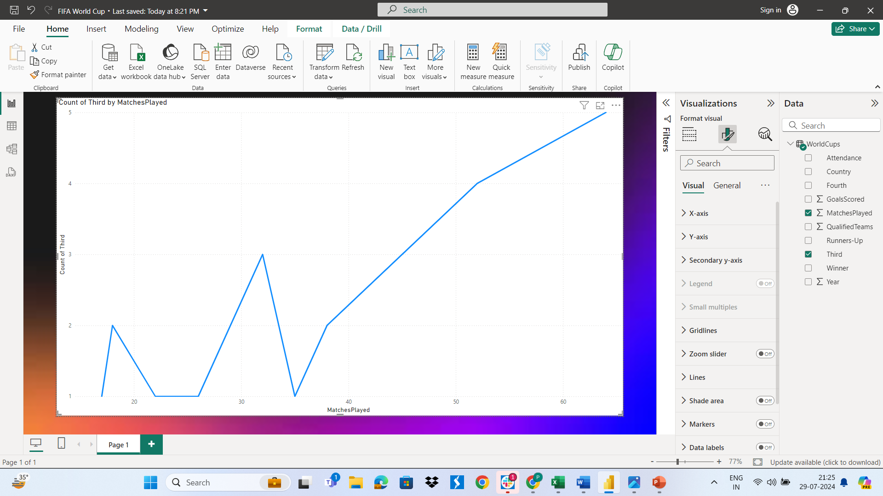
COUNT OF THIRD BY MATCHES PLAYED

Slide 6
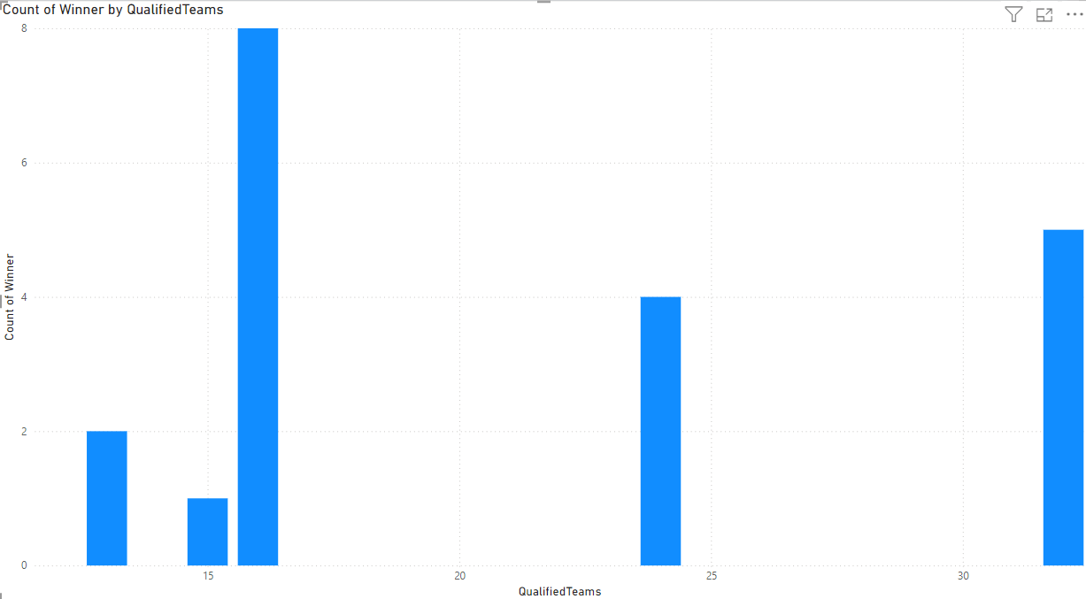
WINNER BY QUALIFIED TEAMS

Slide 7
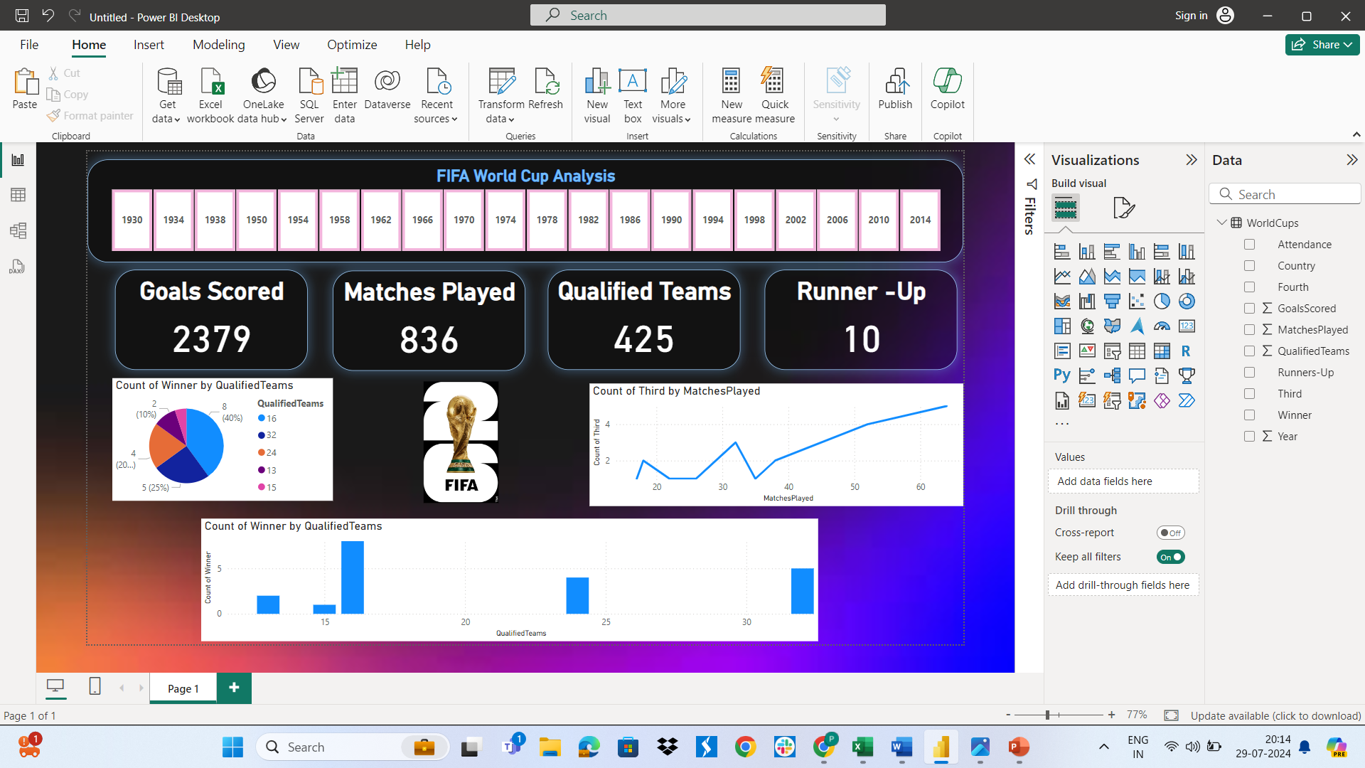
MY DASHBOARD

